Slide 1
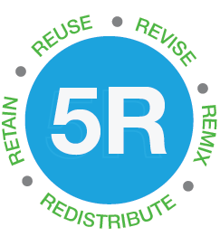
Collaborative Effort:
Institutional OER Initiatives Shared and Discussed
Panel Discussion at the British Columbia Library Association Conference 2017
BC Open Education Librarians, 2017. All content licensed CC BY 4.0 unless otherwise indicated.

Slide 2

Conversation
Starters

Slide 3
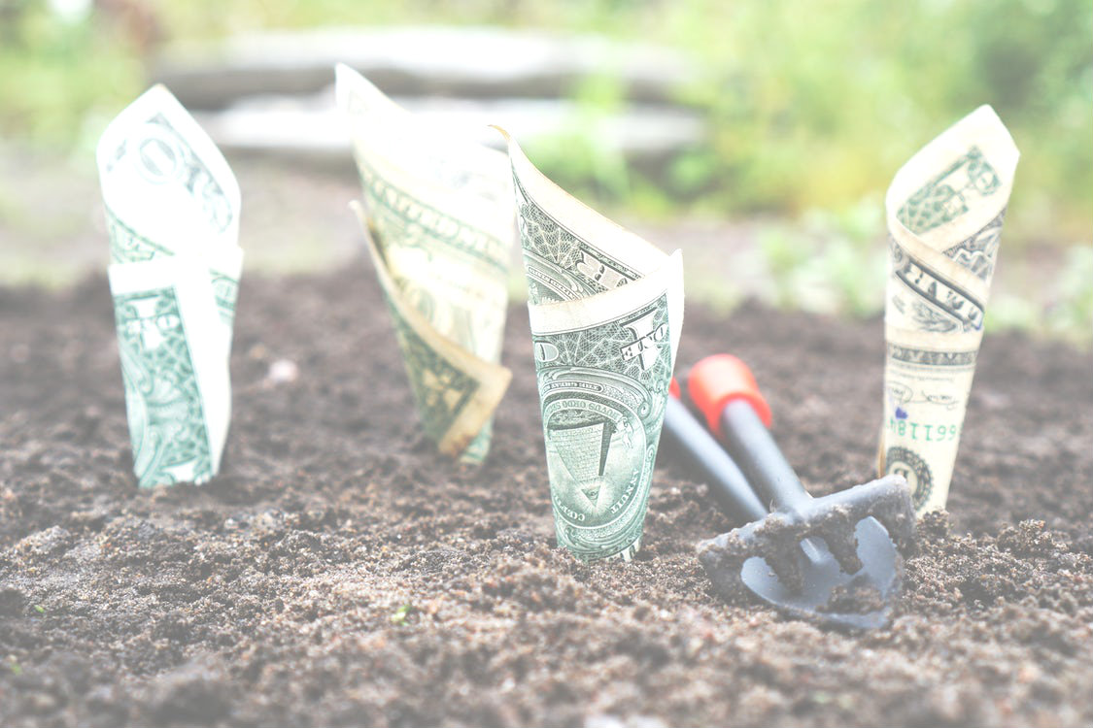
Less emphasis on financial savings.
More emphasis on pedagogical innovation.

Slide 4
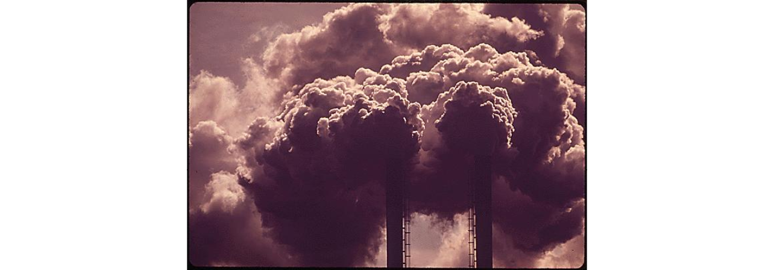
Academic freedom is used as an excuse to avoid trying something new

Slide 5
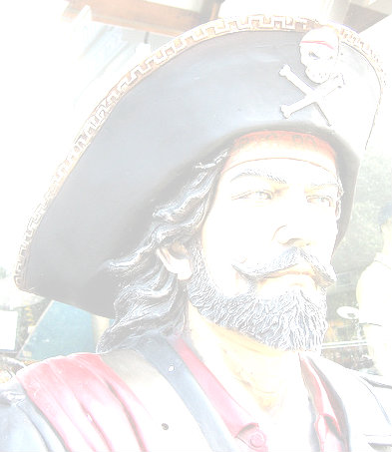
Choose how to direct the intellectual property rights discourse: copyright or copyleft

Slide 6
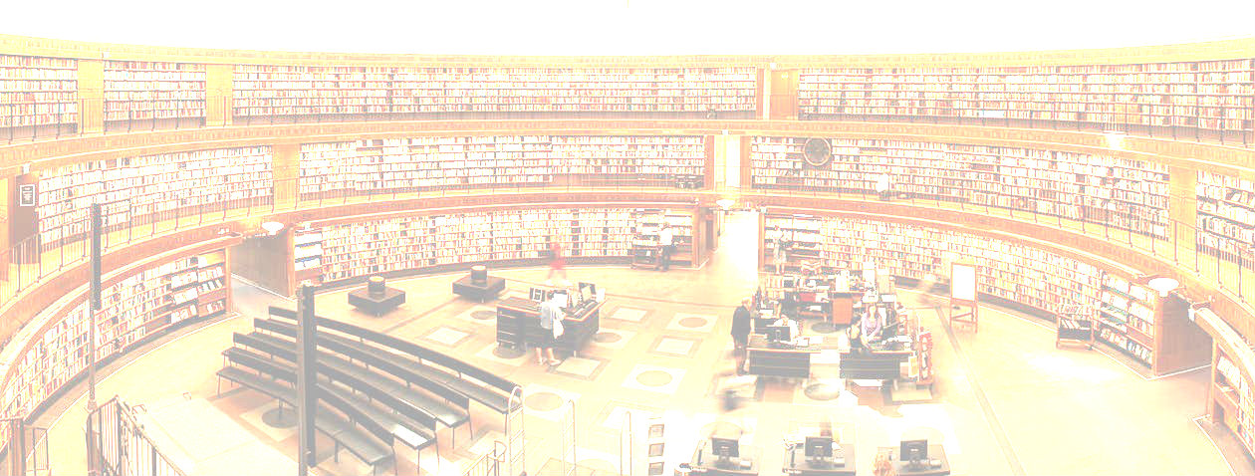
“Learners who are developing their information literate abilities see themselves as contributors to the information marketplace rather than only consumers.”
- Association of College and Research Libraries, Framework for Information Literacy for Higher Education

Slide 7
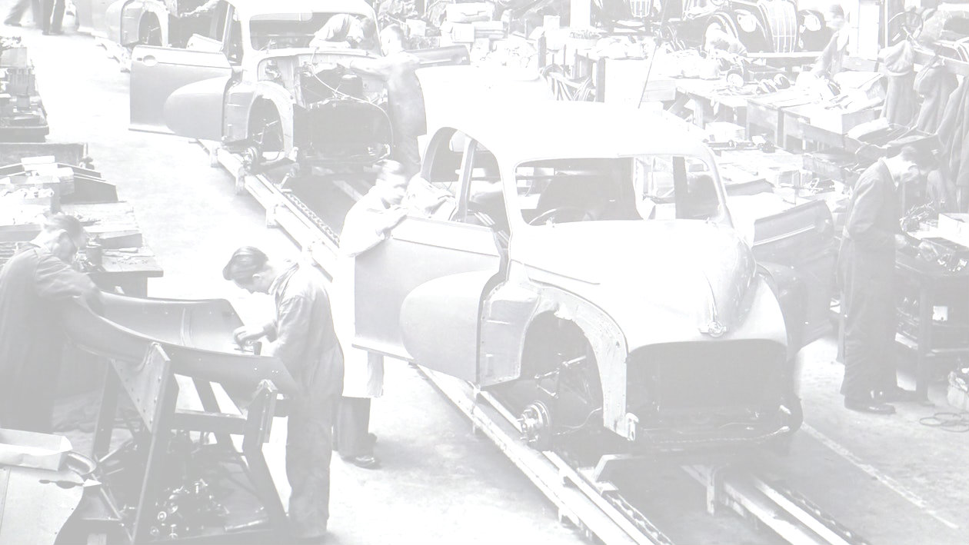
Curate AND Create: Information consumption and production are not separate practices

Slide 8
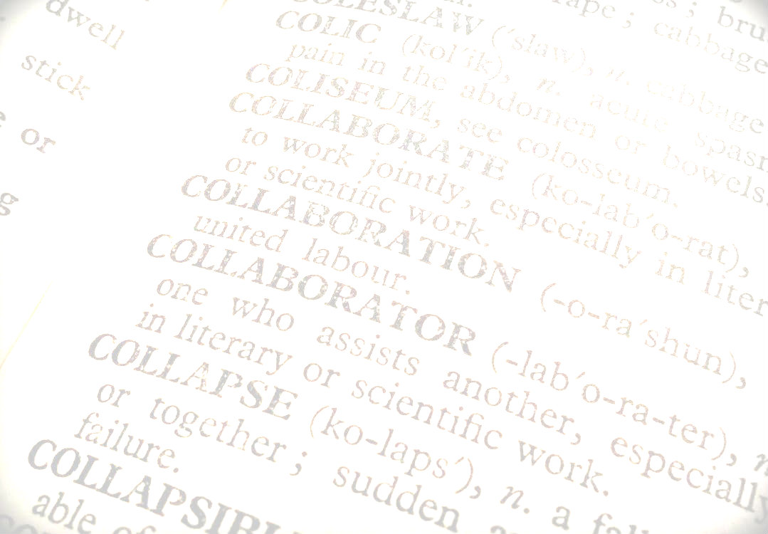
Collaboration is the key value in knowledge production

Slide 9
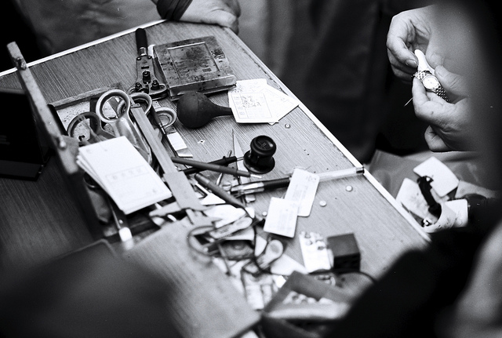
Quality IS an issue
- depending on the discipline

Slide 10
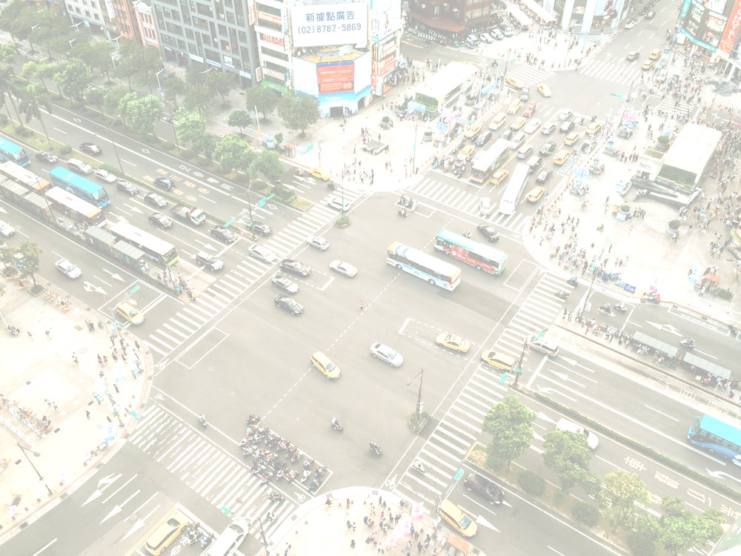
Promote interdisciplinary opportunities

Slide 11

Describe the interrelationship of your teaching practices, libraries, and open education in five years? Ten years?

Slide 12
Questions?

Slide 13
Panelists:
Farhad Dastur, Psychology Department, Kwantlen Polytechnic University
Farhad.Dastur@kpu.ca
Arthur Gill Green, Geography Department, University of British Columbia/Okanagon College
Arthur.Green@geog.ubc.ca
Ken Jeffrey, Graphic Communications Technology, British Columbia Institute of Technology
Kenneth_Jeffery@bcit.ca
Regrets: Rajiv Jhangiani, Psychology Department, Kwantlen Polytechnic University
Rajiv.Jhangiani@kpu.ca
Session Facilitator: Martin Warkentin, Library, University of the Fraser Valley
martin.warkentin@ufv.ca

Slide 14
Image Sources
In order of appearance:
5Rs Logo. Adapted from BCOER poster. https://open.bccampus.ca/bcoer-librarians/bcoer-tools/ CC BY 4.0
Adapted untitled image of microphone https://www.pexels.com/photo/night-music-band-microphone-9137 By Tookapic, 2015. CC0
Adapted from U.S. Dollar Bills Pin Down on the Ground https://www.pexels.com/photo/u-s-dollar-bills-pin-down-on-the-ground-164474/ By The Digital Way, nd. CC0.

Slide 15
Image Sources continued
Adapted from Sulphur Fumes Pour Out Of The Smokestacks Of The Olin Mathieson Chemical Plant https://research.archives.gov/id/546237 By National Archives (College Park, MD), 1972.
Adapted from Pirate https://tinyurl.com/m6pcl9w By Kate Haskell (Flickr), 2009. CC BY 2.0.
Adapted from untitled library image https://www.pexels.com/photo/library-university-books-students-12064/ By Tamás Mészáros, 2014. CC0

Slide 16
Image Sources continued
Adapted from Gray Scale Photo of Car Factory https://www.pexels.com/photo/gray-scale-photo-of-car-factory-188710/ By Mike, 2016. CC0
Adapted from untitled image of open dictionary https://www.pexels.com/photo/blur-book-close-up-data-270233/ By diannehope14, nd. CC0.
Adapted from Repairing Watches https://tinyurl.com/kr27bcg By Leniner (Flickr), 2013. BY NC 2.0.
Adapted from Aerial Photography of Cars on Road Intersection https://www.pexels.com/photo/aerial-photography-of-cars-on-road-intersection-186537/ By Joey Lu, 2016. CC0.

Slide 17
Image Sources continued
Adapted from Close-up of Snowflakes https://static.pexels.com/photos/314829/pexels-photo-314829.jpeg By Myriams-Fotos, 2017. CC0

