Slide 1
Growing the
B.C. Open Collection
Josie Gray (she/her)
BCcampus
jgray@bccampus.ca
April 17, 2023

Slide 2
Vision Statement
The B.C. Open Collection is an OER collection where people can find open and free textbooks to use or modify for many subject areas in the province.
Our users choose to go to the BCcampus site because it makes textbook selection easy by narrowing the vast selection of OER into a high-quality curated list of the most relevant textbooks for BC institutions.
Notes:
This vision statement informed the redesign of the B.C. Open Collection, and it also informs out collection criteria.

Slide 3
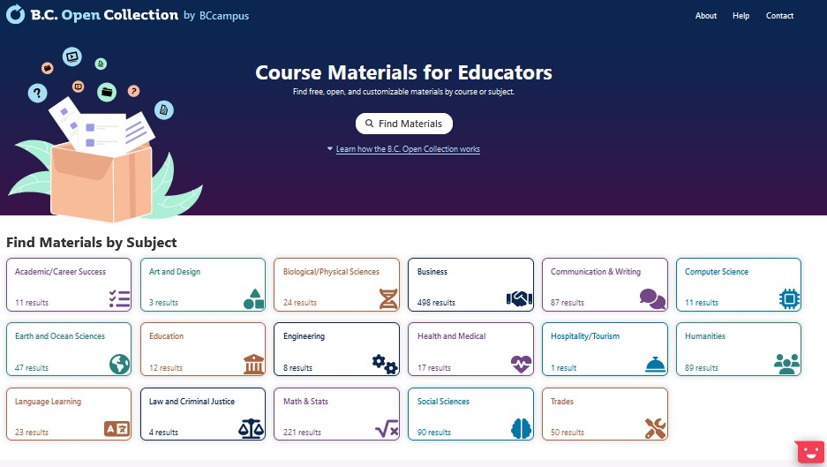
Changes to the collection in the last year
New website and backend –accessible and better metadata
Now includes courses
Student-focused resources only (no ProD resources)
Notes:
There are a number of changes that have happened with the collection in the last year.
The biggest is the new website and backend. The collection infrastructure was completely redesigned with the main goal of making it easier for people to use to find materials. This collection meets web accessibility guidelines and has much better metadata and searching.
Another big change is the inclusion of courses all of which were created by BC instructors and funded by BCcampus.
Another big change was the decision to be strict about only included student-focused resources in the collection. Which means we took out all pro-d materials that were aimed at faculty and staff.

Slide 4
Collection Overview
344 textbooks
15 courses
650 course materials
Notes:
This is an overview of the collection. Note that these numbers change all the time.
It has 344 textbooks
15 courses.
And those 15 courses are made up of 650 course materials – syllabuses, assignments, readings, etc.
Right now, we are only actively accepting suggestions for textbooks. This is in part due to capacity – textbooks are relatively straightforward to deal with since they are pretty consistent in their form while courses can be really different.
But it’s also due to the design of the system – the collection currently doesn’t support the inclusion of individual OER that are not associated with a textbook or course.

Slide 5
Collection Criteria - Required
Textbook elements
Openly licenced
Accessible
Canadian relevance
An editable file
A PDF file and cover
High quality
Notes:
This is the collection criteria. If a textbook doesn’t meet each of these criteria, we don’t add it to the collection.
So the first thing is it needs to be a textbook. Defining a textbook is kind of tricky, but generally we are looking for a book to have things like learning objectives, activities, and other learning supports for students. We are not a collection for monographs.
The second is that it needs an open licence that allows for editing. We do sometimes post ND content, but that is decided on a case by case basis.
The second is that the book needs to meet the BCcampus OER accessibility criteria. This is a new requirement added in the last year, and I will talk a little more about it in a few slides.
The third is that the book must be applicable to a Canadian context. We interpret this really broadly – basically it’s used as a reason to reject textbooks that would require major adaptation to be used in a Canadian classroom. So an example would be an American law textbook.
Then the book must have an editable file that allows for adaptation. The book must have a PDF file and cover so it can be printed.
And then finally, the book must be high quality. Again, this criteria is interpreted broadly, but for this category we are generally looking to ensure the resources is well designed, clear language free of errors, and copyright compliant.

Slide 6
Collection Criteria - Preferred
Indigenous perspectives and pedagogies
Universal Design for Learning (UDL) and open pedagogies
Equity focused
Reviewed
Have supplemental resources
Include interactivity and multimedia
Are currently being used in a Canadian classroom.
Notes:
In the last year, we’ve also added a number of preferred criteria. This is to help us identify resources we should prioritize.

Slide 7
How We Identify Resources
External
Someone fills out the “Suggest a Textbook” form.
collection.bccampus.ca/suggest-textbook
Internal
BCcampus staff making note of books we find.
Notes:
So there are two ways we identify resources to post.
For anyone outside of BCcampus, we have a “Suggest a Textbook” form that you can fill out. It’s located at collection.bccampus.ca/suggest-textbook. You can also find it in the footer of the collection. This suggestion form asks for information about the suggested textbook and also takes you through each of the required and preferred criteria. For the required criteria
BCcampus staff also keep eyes out for open textbooks and we keep an internal list of anything we find.
Regardless of where the suggestion comes from, it’s generally me who reviews the book against our criteria and makes decisions about what to add and when.

Slide 8
Challenges
One person making decisions
So many open textbooks, need to prioritize
Identifying the accuracy of the material
The time it takes to review for accessibility
Notes:
So there are a number of challenges that I am currently experiencing when it comes to adding new resources to the B.C. Open Collection.
The first is that I am making decisions about whether or not to add a textbook to the collection and what to prioritize on my own, and I don’t think that is the best way to ensure this collection meets the needs of the BC open educators.
The second is that there are now more open textbooks in the world than we could ever hope to post in the collection, especially considering that one of the goals of the B.C. Open Collection is to be curated, which means there are decisions to be made around how to prioritize the books I could add.
Third is that I do not have the ability to evaluate the subject matter covered in textbook to determine its accuracy and relevancy.
And finally, most resources are not accessible, and it takes a lot of my time to give authors feedback on how to revise their content to make it accessible.

Slide 9
Potential Resolution: A Committee
A group to review suggested open textbooks on an ongoing basis.
Goals
  Allow for community input on what gets added to the BC Open Collection
  Benefit from expertise that BCcampus doesn’t have
  Make the work more sustainable
Notes:
Due to these challenges, I have been wanting to set up a committee to help me review and prioritize open textbooks to add to the collection. My hope would be that a committee would allow for
A more collaborative process to inform what gets prioritized for the collection informed by the open community in BC
The ability to bring in or connect with people with knowledge about subject matter to help evaluate accuracy of content
And make the work more sustainable by distributing the work of reviewing across multiple people.
So in addition to being here to share more about the collection and how it works, I would also love the opportunity to get feedback and your thoughts on setting up a collection committee, and also gauge your interest in whether you’d be interested in getting involved, or whether you know of others who may be interested.

Slide 10
Questions and Discussion

