Slide 1
An Unlikely Mix?
Applying Kanban, sales and marketing strategy to open education groups.
Ross C McKerlich
BCcampus
rmckerlich@bccampus.ca
March 9th, 2020

Slide 2
Acknowledgement
For thousands of years the Syilx (Okanagan) Peoples have walked gently on the unceded territories where we now live, work, and play. We are committed to building relationships with the first peoples here, one based in honour and respect, and we thank them for their hospitality.

Slide 3
Who Is Ross?
Notes:
Open Education Advisor, Open Education Advocate – member of OC group, Researcher, Dad, Husband

Slide 4
Who are you?
How many participants here are currently part – or have been a member - of an open education group?

Slide 5

Open Education is all about relationships.
CC 0 RawPixel
Notes:
Added as a bookend to make sure our participants know its still all about relationships

Slide 6


Genesis of ideas
Nicole Finkbeiner, OpenStax Institutional Partner Program
My own experience in open working groups:
Open Education Groups
Passion
Progress

Slide 7
Business and Open Education
Kanban
Sales
Open Ed
Marketing

Slide 8
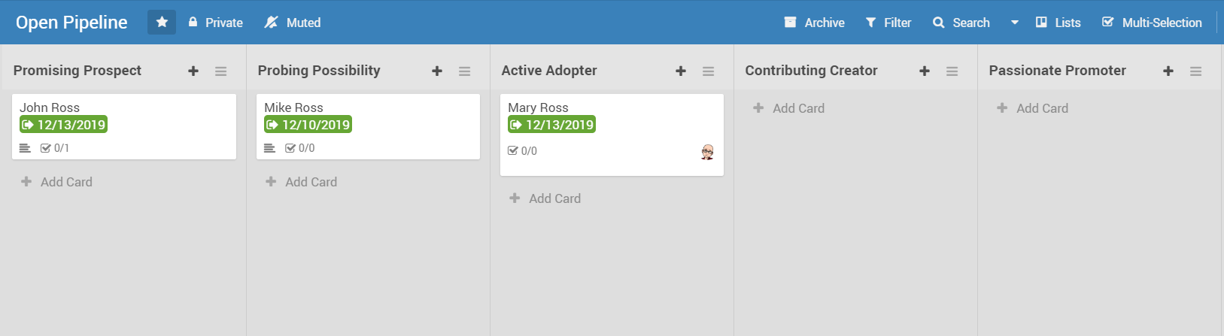
Applying Kanban To Open Education
Open
Notes:
Visual, often online, “swim lane” tool.

Slide 9
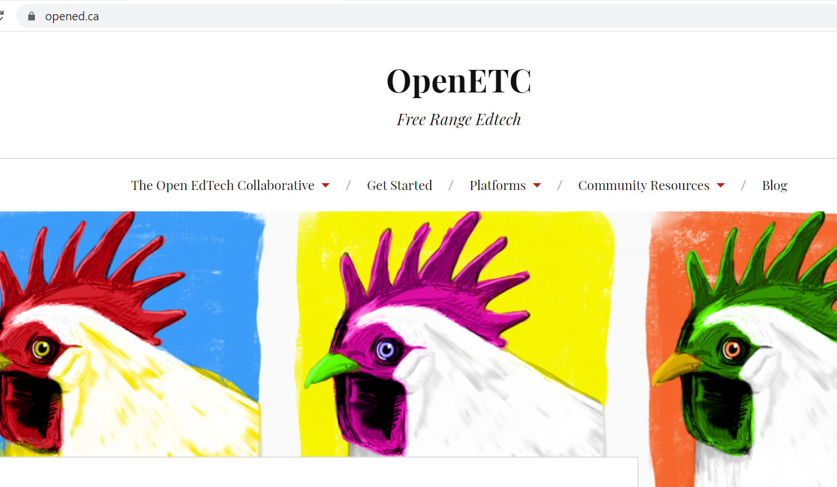
OpenEd.ca
Notes:
Wekan, part of sandstorm. User admin with tool.

Slide 10
Applying Kanban To Open Education
Kanban is both a workflow management tool and a project management tool.
Workflow management focuses on getting things done (what) whereas project management is a plan to achieve a goal (how).
Both have application to open education work.
Kanban could be useful to ensure progress as well as passion.
Open

Slide 11
Poll
Is there sales and marketing in open education work?
Open

Slide 12
Applying Sales To Open Education
Faculty have to switch products. From a published resource to an open resource.
There is a journey from non open to open.
As an open education group it could be useful to track where faculty are in terms of that journey.
Remember – no labeling. Still relationship building.
Open

Slide 13
Applying Sales and Kanban to Open Education
Open
Notes:
Go over the different pipeline stages

Slide 14
Applying Marketing To Open Education
It takes different strategies to reach faculty about open.
Do the 4 Ps apply? Product, Price, Promotion, Place
What does a marketing mix look like for open education?
It takes planning and evaluation of each campaign to get the right mix.
Combine Kanban with open strategy database that you can plan once per year and it could be useful.
Open

Slide 15
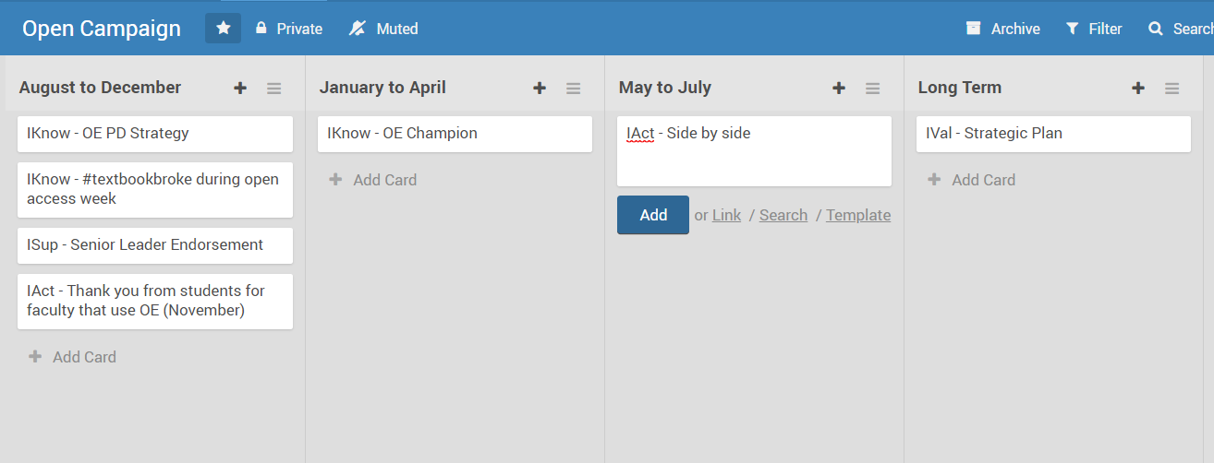
Applying Marketing and Kanban to Open Education
Open

Slide 16
Open Education is all about relationships.
CC 0 RawPixel
Notes:
Added as a bookend to make sure our participants know its still all about relationships

Slide 17
Wrapping Up
A workflow management tool like Kanban could be useful for coordinating open group work so that there is passion and progress.
There is sales in open education work. Combining sales and Kanban could be useful for tracking potential adopters and creators.
There is marketing in open education work. Combining marketing, Kanban and the open strategy database could be useful for planning, executing and evaluating open education campaigns.
Open

Slide 18

Is it really an unlikely mix? Or?
Evan Amos Reeses-PB-Cups-Nov 29 2010 – Wikimedia Commons – USA- 640X231 px- photograph

Slide 19
Questions?
Feedback welcome! rmckerlich@bccampus.ca

